Slide 1
Social Media Marketing
Strategy Guide

Slide 2
[insert company name]

Slide 3
Finding Our Audience: What Problem Are We Solving?
What problem is our company trying to solve?
[Insert answer]
What are the pain points our customers are experiencing?
[Insert answer]
[Insert answer]
[Insert answer]

Slide 4
Finding Our Audience: Who Is Experiencing The Problem We’re Targeting?
What is causing this problem to happen?
[Insert answer]
Who is most likely to experience this problem?
[Insert answer]

Slide 5
Finding Our Audience: What Is Our Target Demographic?
Age
[Insert answer]
Gender
[Insert answer]
Location
[Insert answer]
Industry
[Insert answer]
Job Title
[Insert answer]
Ethnicity
[Insert answer]

Slide 6
Social Media Channel Demographics
Facebook
[insert demographic 1]
[insert demographic 2]
Twitter
[insert demographic 1]
[insert demographic 2]
Instagram
[insert demographic 1]
[insert demographic 2]
Pinterest
[insert demographic 1]
[insert demographic 2]

Slide 7
Why Is Our Audience Buying?
What brought you to [insert company name]?
[insert answer]
What product did you purchase?
[insert answer]
Why did you need [insert product here]?
[insert answer]
What types of problems were you experiencing that lead you to purchasing [product here]?
[insert answer]
Did [product here] help solve your problem?
[insert answer]
If applicable how often do you purchase [product here]?
[insert answer]

Slide 8
Choosing Your Budget Size
This year’s marketing budget:
This year’s social budget:
Percentage of budget going towards paid ads:
Percentage of budget going towards images:
Percentage of budget going towards videos:
Percentage of budget going towards boosted social posts:
Percentage of budget going towards [insert product here]:

Slide 9
Determine Average Interactions
Social Media Channel | Number of Posts | Number of Interactions | Average
Facebook
Twitter
Instagram
Pinterest
Google+

Slide 10
Competitor Research
Top Profiles | Competitor One | Competitor Two | Competitor Three | Competitor Four
Facebook
Instagram
Twitter
Pinterest
Google+

Slide 11
What Types Of Posts Are Working For Our Competitors?
[Example One]
[Example Two]
[Example Three]
[Example Four]

Slide 12
What Types Of Posts Aren’t Working For Our Competitors?
[Example One]
[Example Two]
[Example Three]
[Example Four]

Slide 13
KPI Creation: Traffic
Traffic Baseline:
Facebook
Twitter
Instagram
LinkedIn
Pinterest
Traffic Goal:
Facebook
Twitter
Instagram
LinkedIn
Pinterest

Slide 14
KPI Creation: Follower Growth
Followers on [date here]
Facebook
Twitter
Instagram
LinkedIn
Pinterest
Followers on [one year from current date] goal:
Facebook
Twitter
Instagram
LinkedIn
Pinterest

Slide 15
KPI Creation: Engagement
Engagement Baseline:
Facebook
Twitter
Instagram
LinkedIn
Pinterest
Engagement goal:
Facebook
Twitter
Instagram
LinkedIn
Pinterest

Slide 16
KPI Creation: Reach/Impressions
Reach/Impression Baseline:
Facebook
Twitter
Instagram
LinkedIn
Pinterest
Reach/Impression goal:
Facebook
Twitter
Instagram
LinkedIn
Pinterest

Slide 17
KPI Creation: Conversions
Conversion Baseline:
Facebook
Twitter
Instagram
LinkedIn
Pinterest
Conversion goal:
Facebook
Twitter
Instagram
LinkedIn
Pinterest

Slide 18
Types of Content
Facebook
[Types of shared content]
[Types of shared content]
Twitter
[Types of shared content]
[Types of shared content]
Instagram
[Types of shared content]
[Types of shared content]
Pinterest
[Types of shared content]
[Types of shared content]
LinkedIn
[Types of shared content]
[Types of shared content]
Google+
[Types of shared content]
[Types of shared content]

Slide 19
Social Media Posting Schedule
Facebook
Number of posts per day
Twitter
Number of post per day
Instagram
Number of posts per day
Pinterest
Number of posts per day
LinkedIn
Number of posts per day
Google+
Number of posts per day

Slide 20
Social Media Marketing
Best Practice Info

Slide 21
How often to post on SoMe?

Slide 22
Notes:
Der skal laves nyt grafik hvis vi skal bruge den

Slide 23
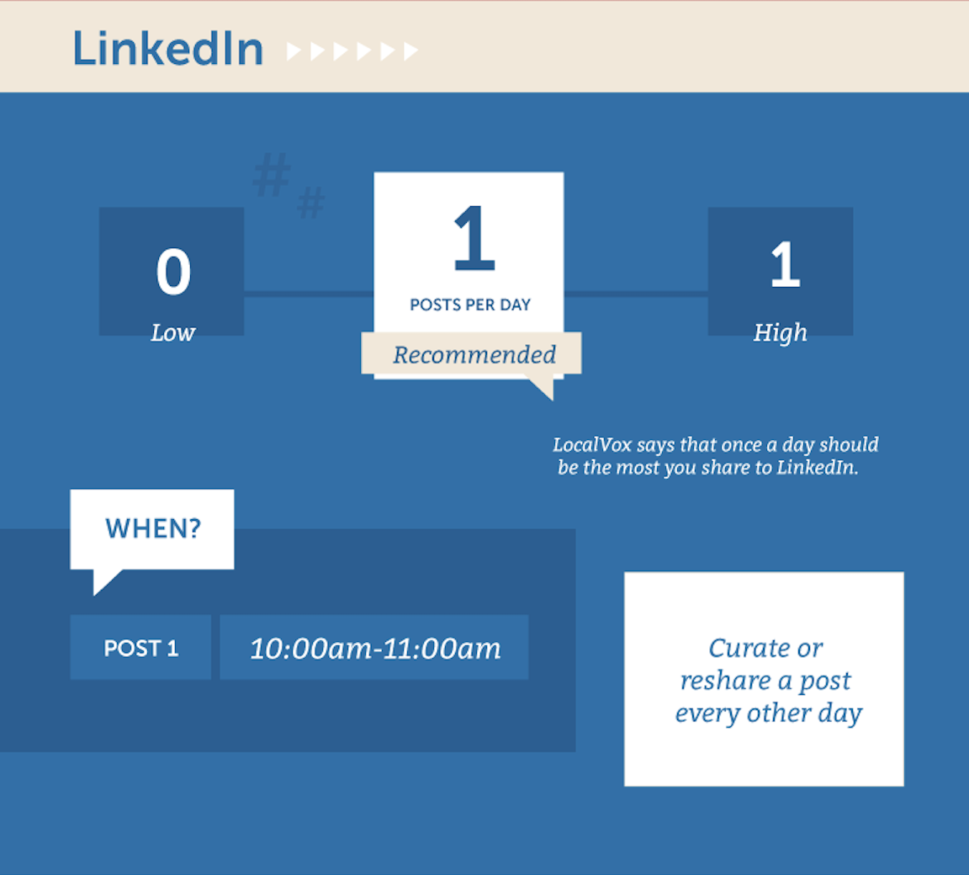
Notes:
Der skal laves nyt grafik hvis vi skal bruge den

Slide 24
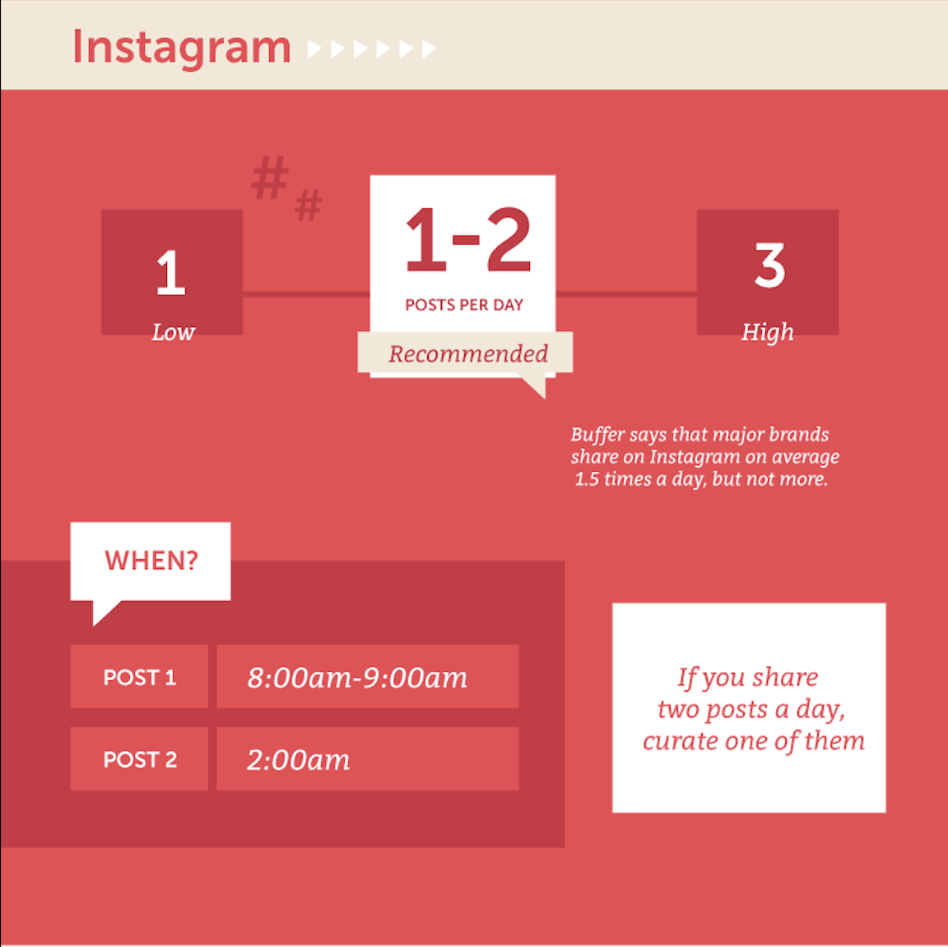
Notes:
Der skal laves nyt grafik hvis vi skal bruge den

Slide 25
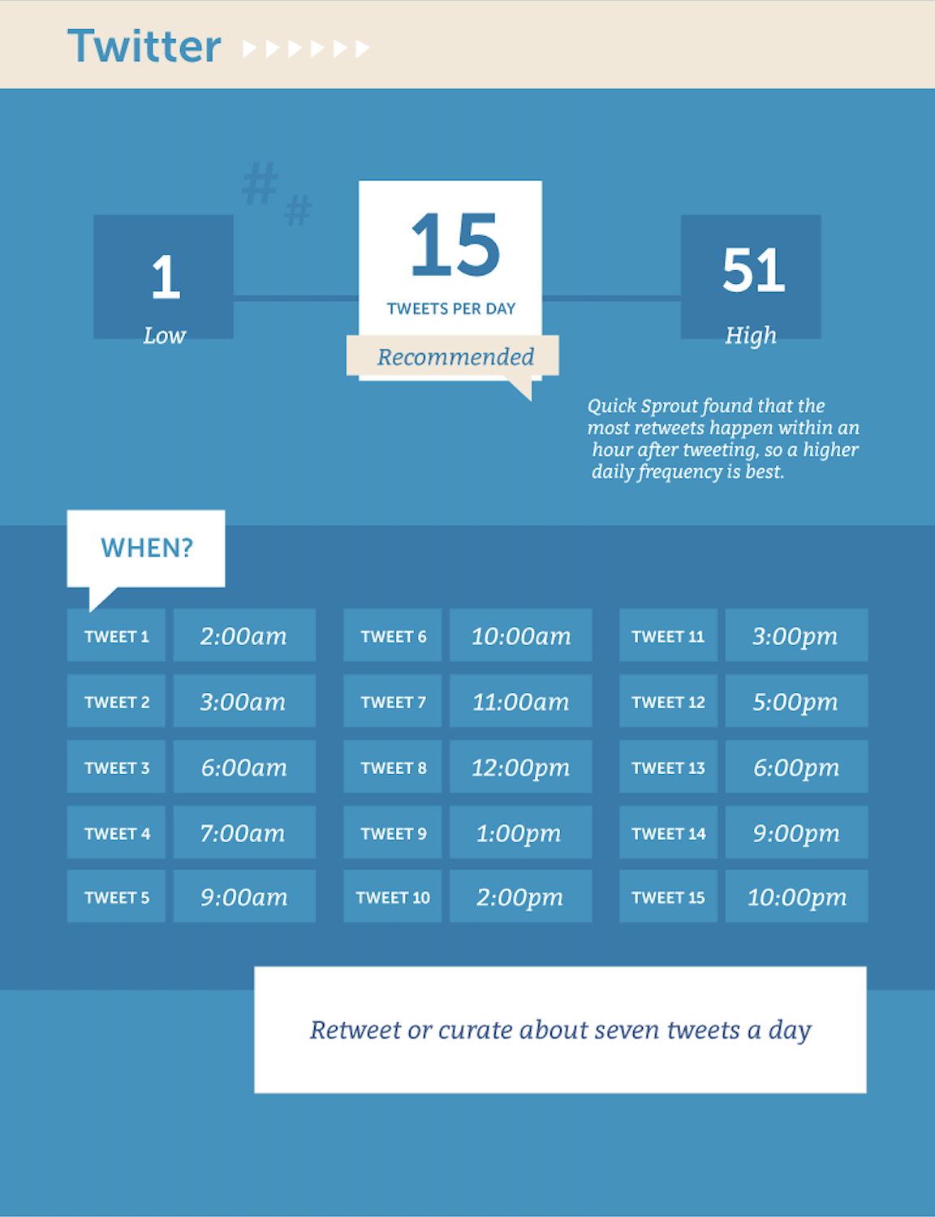
Notes:
Der skal laves nyt grafik hvis vi skal bruge den

Slide 26
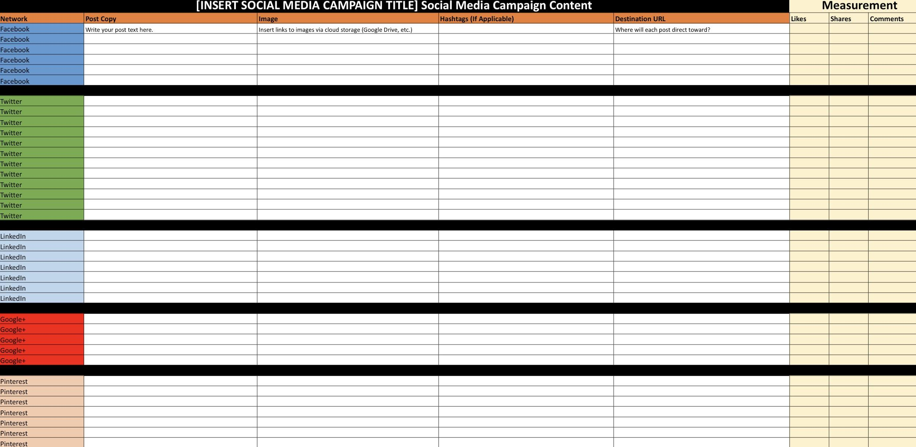

Slide 28
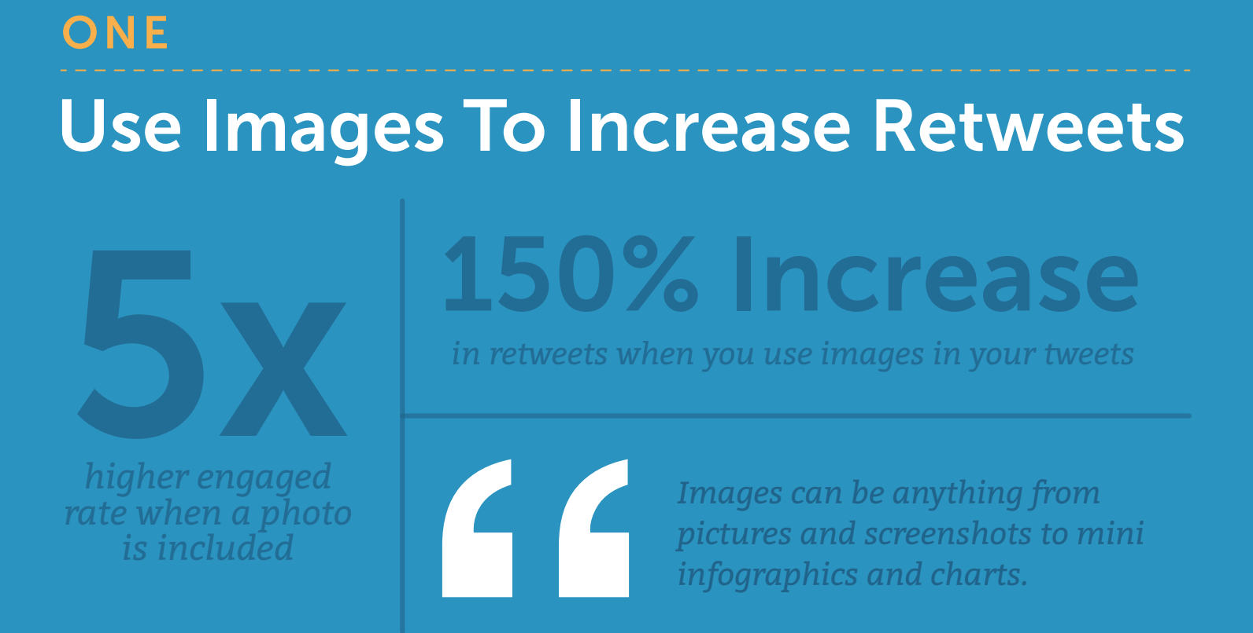

Slide 30
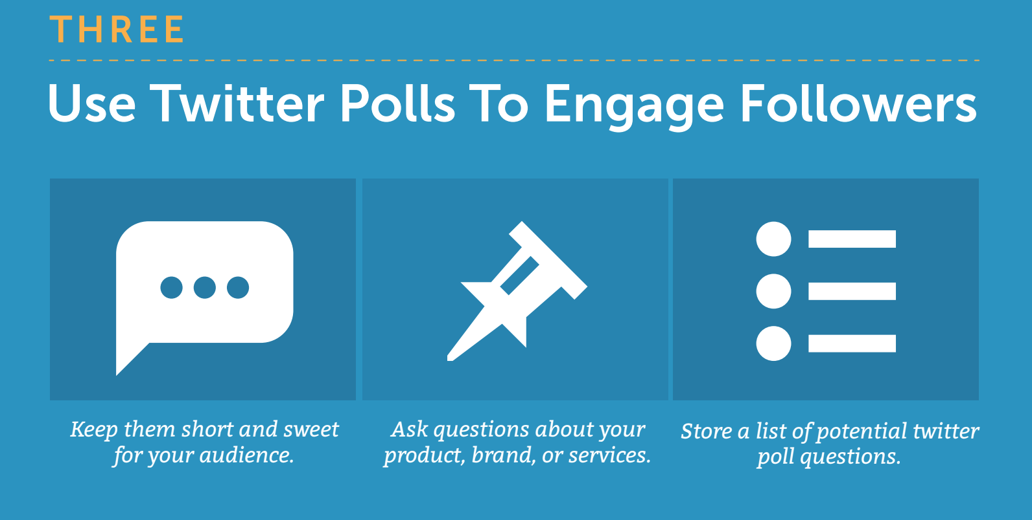

Slide 31
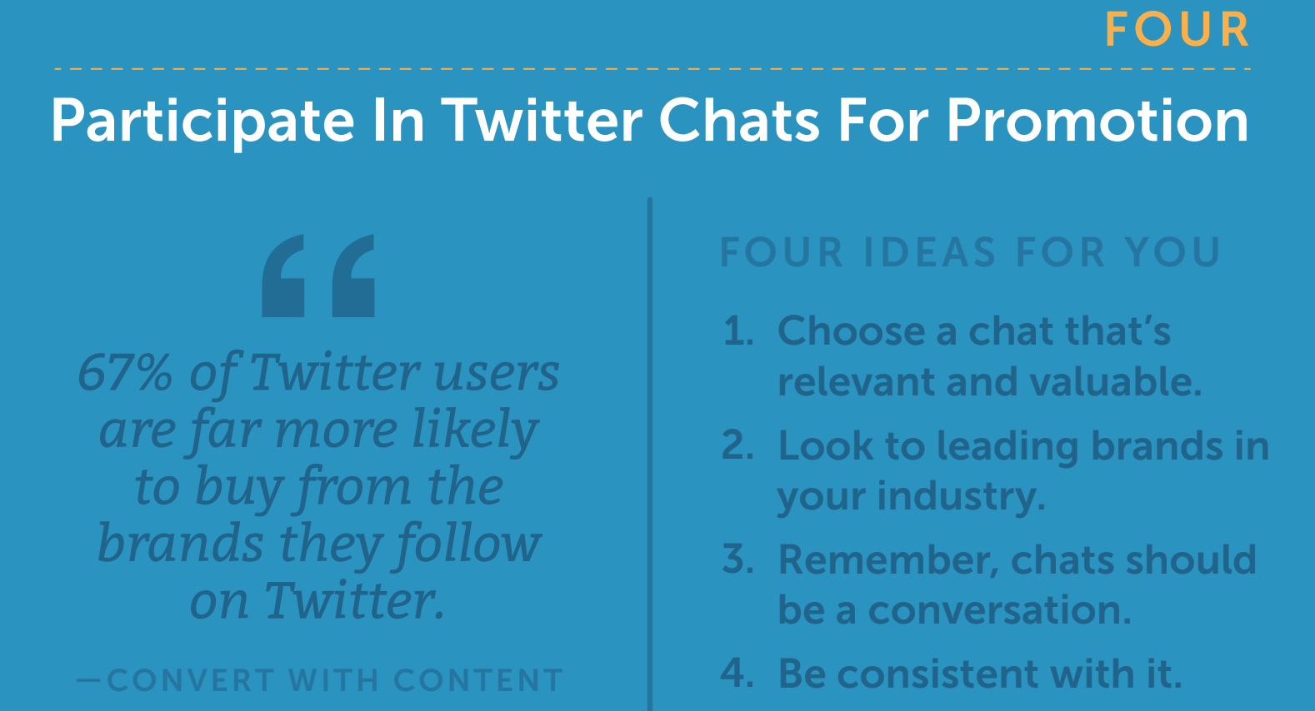

Slide 32
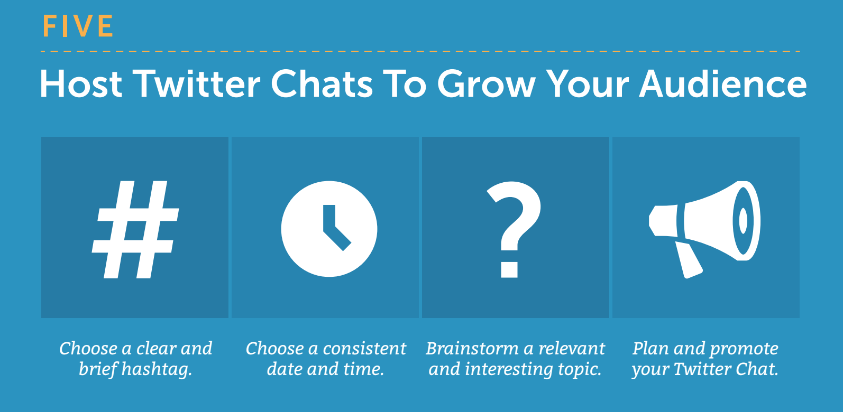

Slide 33
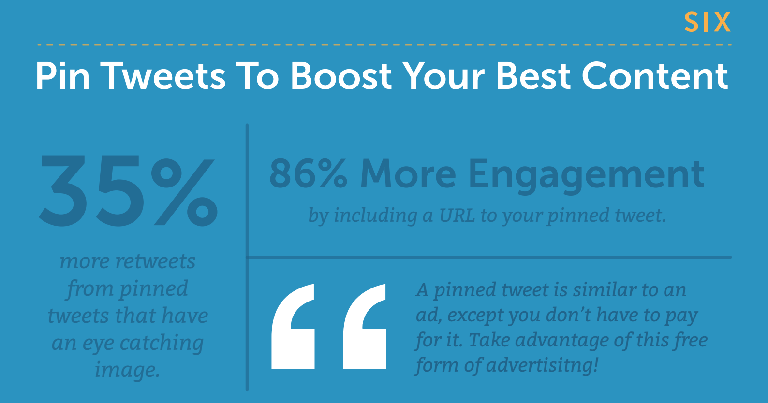

Slide 35
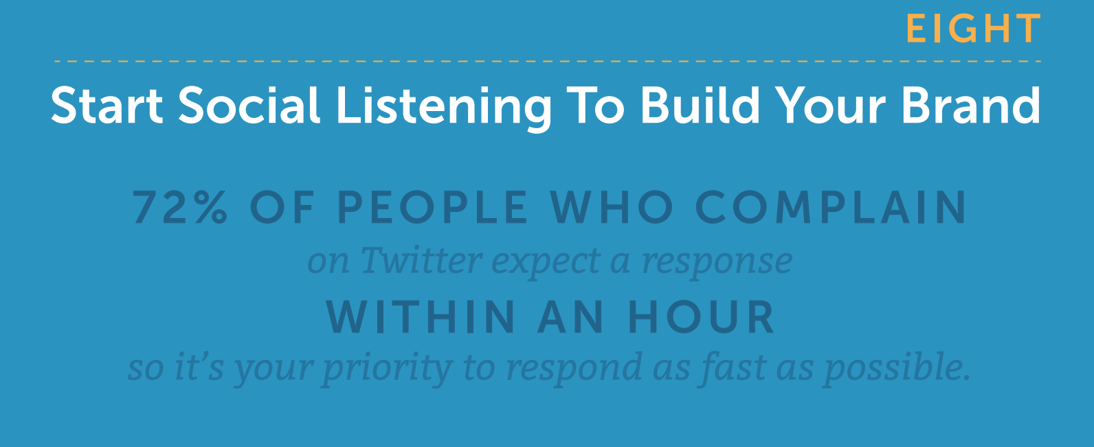

Slide 36
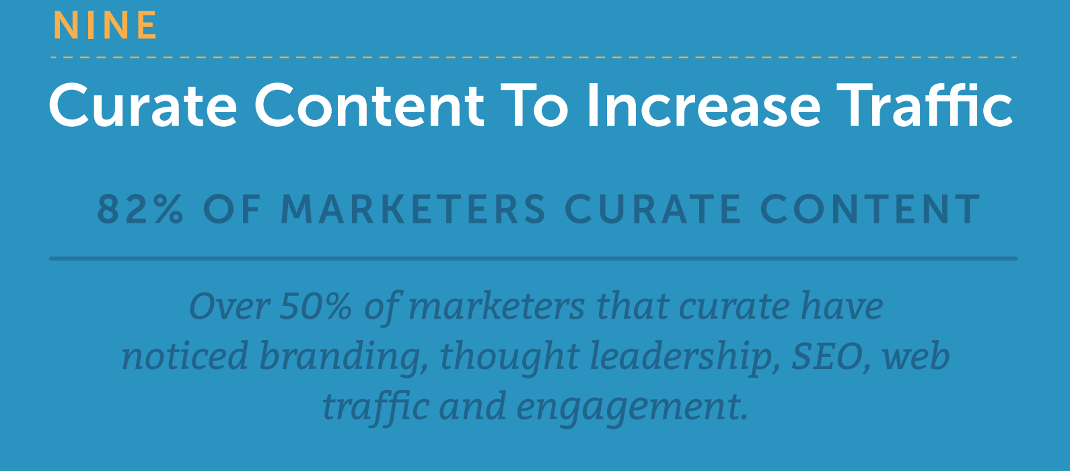

Slide 37
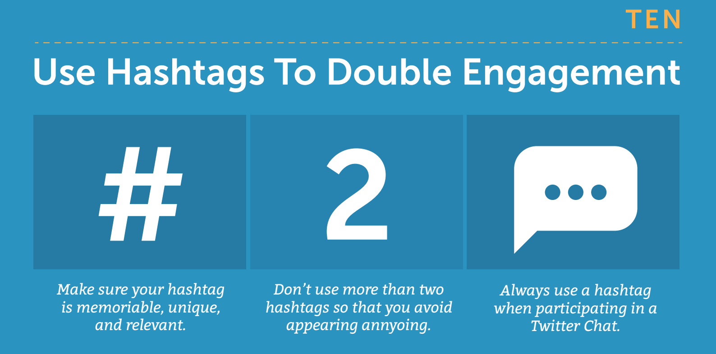

Slide 38
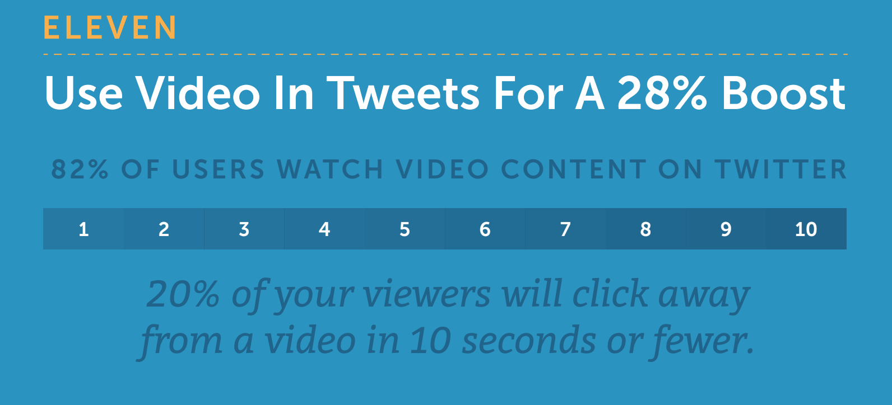

Slide 42
